Slide 1
Sample 8087 Programs

Slide 2
Sample program to find the side of a right angled triangle using pythagoras theorem
data segment word public
sidea dd 3.0
sideb dd 4.0
hyp dd ?
cont_word dw 0
stat_word dw 0
data ends
code segment word public
assume cs:code,ds:data
mov ax,data
mov ds,ax
finit
mov cont_word,03ffh
fldcw cont_word
fld sidea
fmul st,st(0)
fld sideb
fmul st,st(0)
fadd st,st(1)
fsqrt
fstsw stat_word
mov ax,stat_word
and al,0BFh
jnz stop
fstp hyp
stop: nop
int 3
code ends
end

Slide 3
To find the roots of the quadratic equation
data segment
sw dw ?
str1 db "Roots are Imaginary$"
a dd 1.0
b dd 4.0
c dd 5.0
two dd 2.0
four dd 4.0
delta dd ?
sqrtdelta dd ?
roota dd ?
rootb dd ?
data ends
code segment
assume cs:code,ds:data
mov ax,data
mov ds,ax
finit
fld a ;st(0)=a
fld c ;st(0)=c , st(1)=a
fmul ;st(0)=a*c
fld four ;st(0)=4.0 st(1)=a*c
fmul ;st(0)=4*a*c
fld b ;st(0)=b
fmul st(0),st(0) ;st(0)=b^2 ,st(1)=4*a*c

Slide 4
roots of the quadratic equation(Contd)
fsubr ;st(0)=st(0)-st(1)=b^2-4*a*c
fsqrt ;st(0)=sqrt(delta)
fstsw sw
mov ax,sw
and ax,1
cmp ax,1
je imaginary
fst sqrtdelta
fld b ;st(0)=b,st(1)=sqrt(delta)
fchs ;st(0)=-b, st(1)=sqrt(delta)
fadd ;st(0)=-b+sqrt(delta)
fld a ;st(0)=a , st(1)=-b+sqrt(delta)
fld two ;st(0)=2.0, st(1)=a , st(2)= b+sqrt(delta)
fmul ; st(0)=2*a, st(1)=-b+sqrt(delta)
fdiv ; st(0)=((-b+sqrt(delta))/2a) i.e, root1
fst roota
fld sqrtdelta ; st(0)=sqrt(delta) st(1)=root1
fld b ; st(0)=b st(1)=sqrt(delta) st(2)=root1
fchs ; st(0)=-b st(1)=sqrt(delta) st(2)=root1q
fsubr; st(0)=st(0)-st(1)=-b-sqrt(delta), st(1)=root1
fld a ; st(0)=a st(1)=-b-sqrt(delta) st(2)=root1
fld two ; st(0)=2 st(1)=a st(2)=-b-sqrt(delta) st(3)=root1
fmul ; st(0)=2*a st(1)=-b-sqrt(delta) st(2)=root1
fdiv ; st(0)=st(1)/st(0)=(-b-sqrt(delta))/(2*a) i.e. root2, st(1)=root1
fst rootb
jmp exit
imaginary: mov ah,9
lea dx,str1
int 21h
exit: int 3
code ends
end

Slide 5
Algorithm to find X^{y}
Load base, power.
Compute (y )*( log2 x)
Separate integer(i) ,fraction(f) of a real number
Divide fraction (f) by 2
Compute (2 ^{f/2}) * ( 2 ^{f/2})
Let Z=X^{y}
Taking log on both the sides
Log₂Z=y Log₂X
=>Z=2^{yLog2X}
Let’s say that y Log2X=3.65
=>Z=2^{3.65}
3.65=>3.0+0.65 (Int+ Frac)
Z=2³ * 2^{0.65}
=>8*m

Slide 6
Program to find X^{y}
data segment
y dd 2.5
x dd 3.0
whole dd ?
fraction dd ?
two dd 2.0
ans1 dd ?
ans2 dd ?
finalans dd ?
integer dd ?
cw dw 0fffh
data ends
code segment
assume cs:code,ds:data
mov ax,data
mov ds,ax
finit
fldcw cw
fld y
fld x
fyl2x
fst whole
frndint
fst integer
fld whole
fsubr
fst fraction
fld two
fdiv
f2xm1
fld1
fadd
fmul st(0),st(0)
fst ans1
fld integer
fxch
fscale
fst finalans
int 3
code ends
end

Slide 7
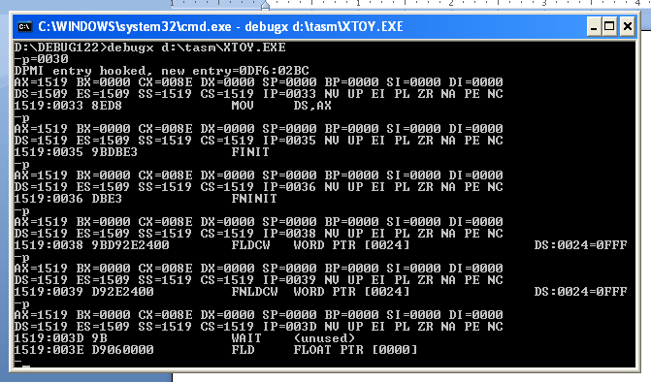
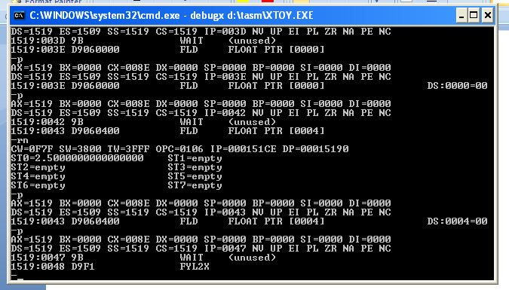

Slide 8
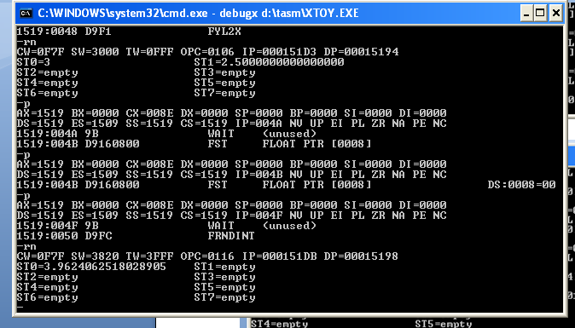
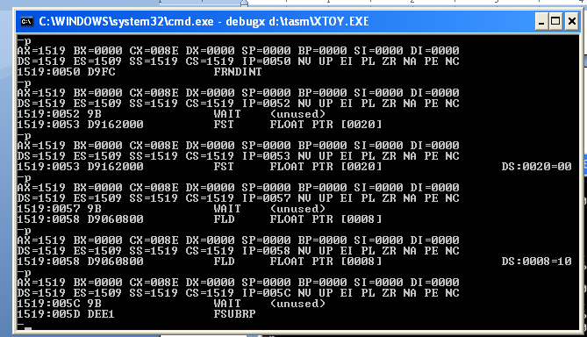

Slide 9
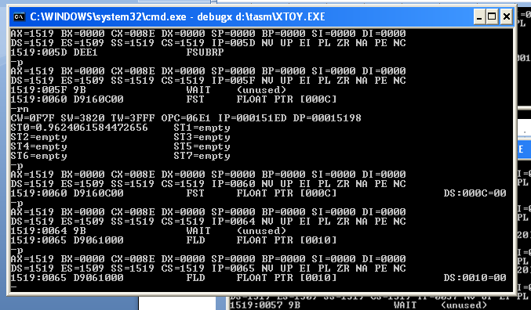
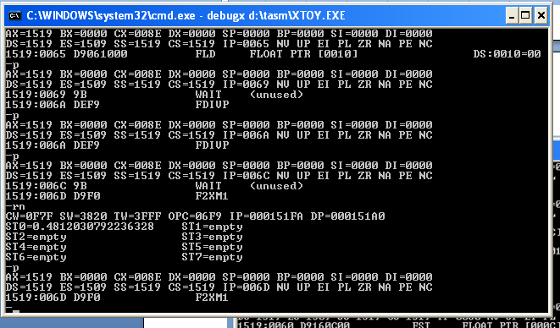

Slide 10
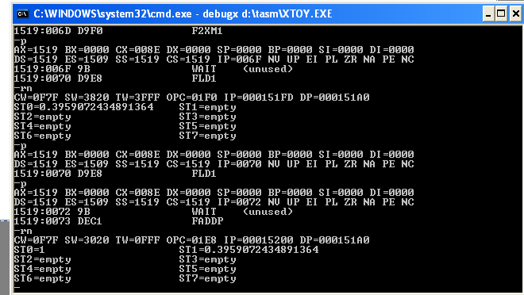
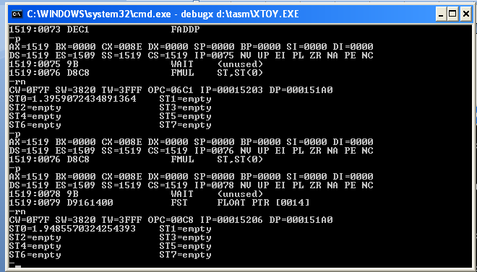

Slide 11
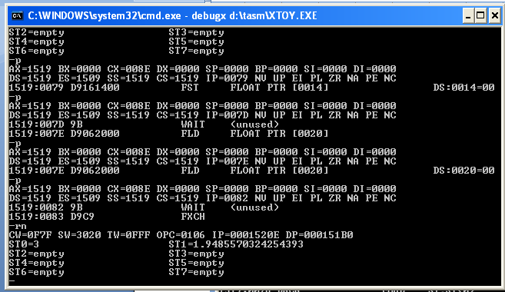
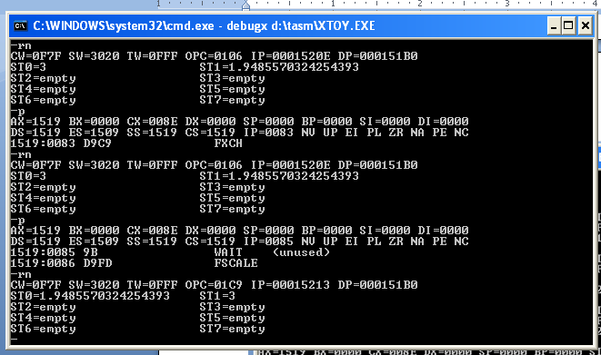

Slide 12
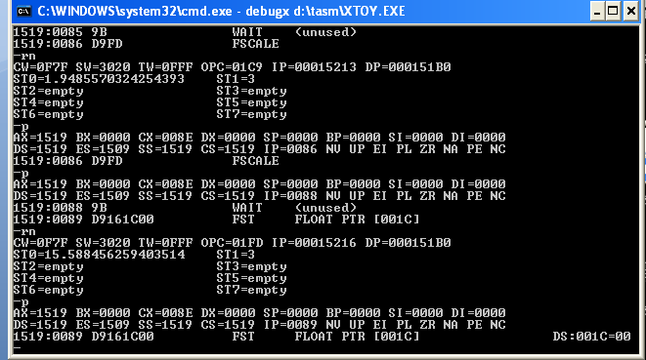
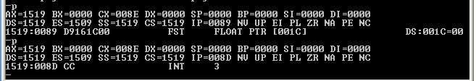

Slide 13
Program to find sinӨ
data segment
one dd 1.0
two dd 2.0
tanthetabytwo dd ?
n dd ?
d dd ?
theta dd 60.0
thetar dd ?
x dd 180.0
ans dd ?
data ends
code segment
assume cs:code,ds:data
mov ax,data
mov ds,ax
finit
fld theta
fldpi
fmul
fld x
fdiv
fld two
fdiv
fptan
fdiv
fst tanthetabytwo
fld two
fmul
fst n
fld one
fld tanthetabytwo
fmul st(0),st(0)
fadd
fdiv
fst ans
int 3
code ends
end

Slide 14
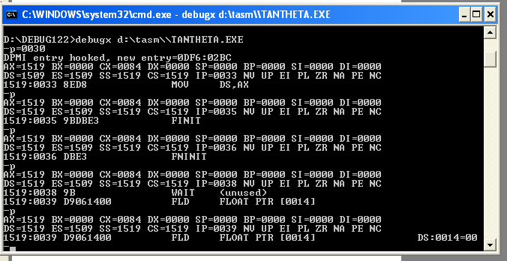
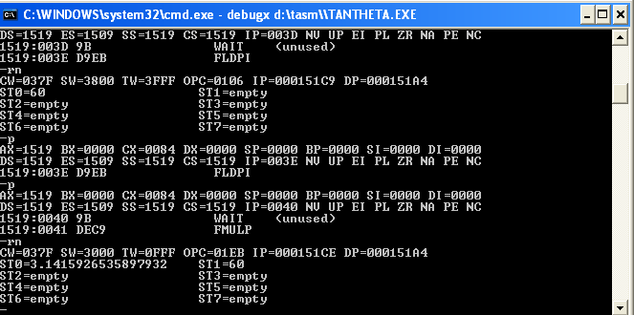

Slide 15
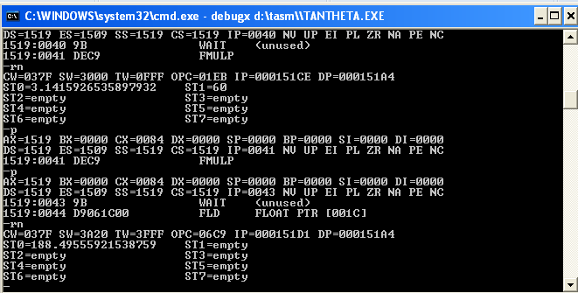
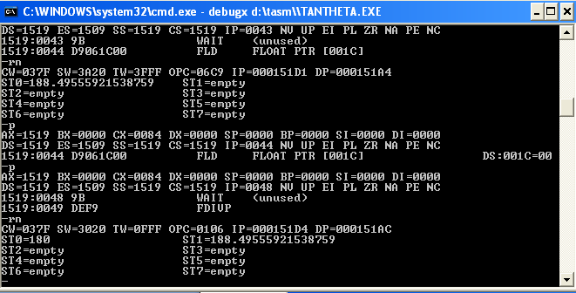

Slide 16
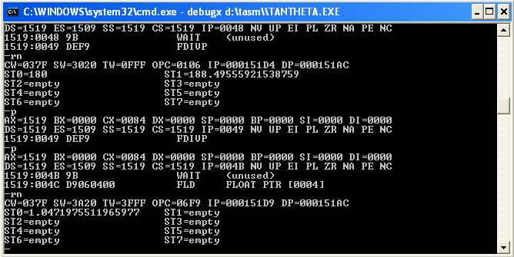
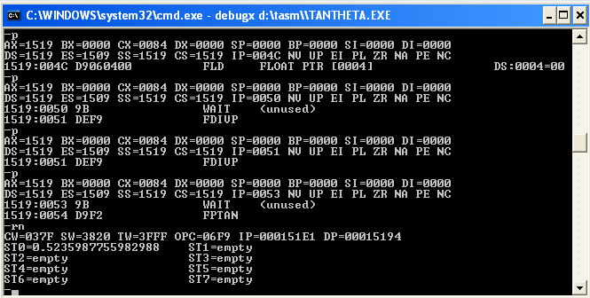

Slide 17
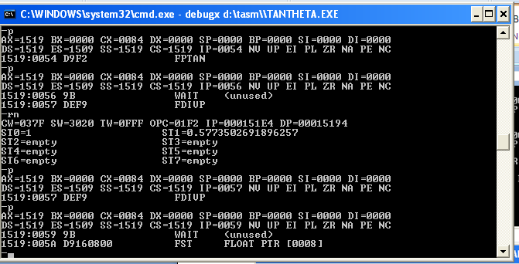
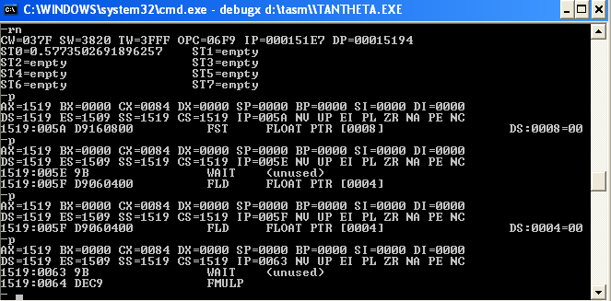

Slide 18
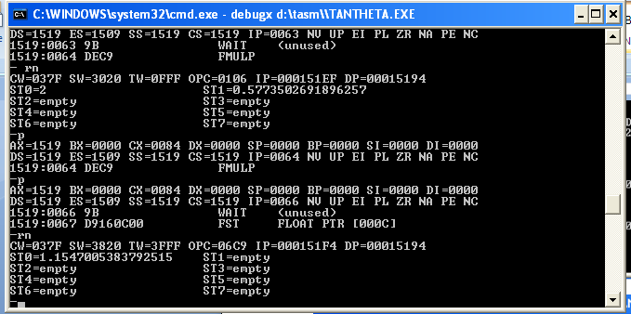
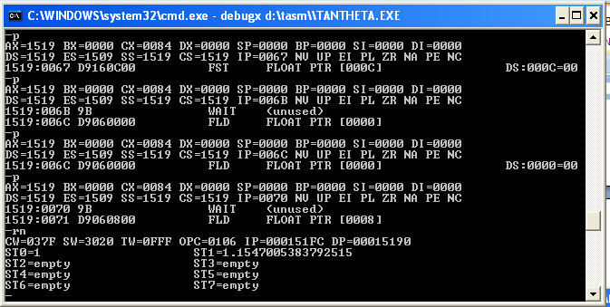

Slide 19
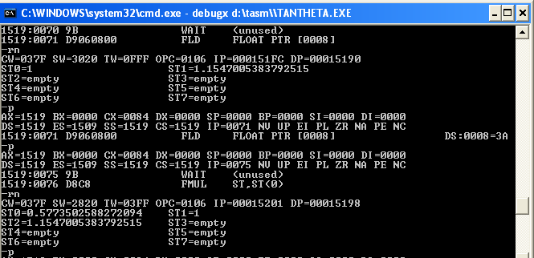
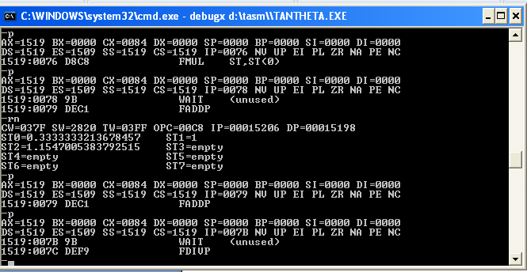

Slide 20
